Slide 1

Demystifying Skill Development in Education Research
Barbara Fenesi, Ph.D.
Assistant Professor
Faculty of Education
Brain Mind Institute
WEBB Lab - webbresearch.ca

Slide 2
My research program
To understand how classroom-based physical activity impacts student success.

Slide 3
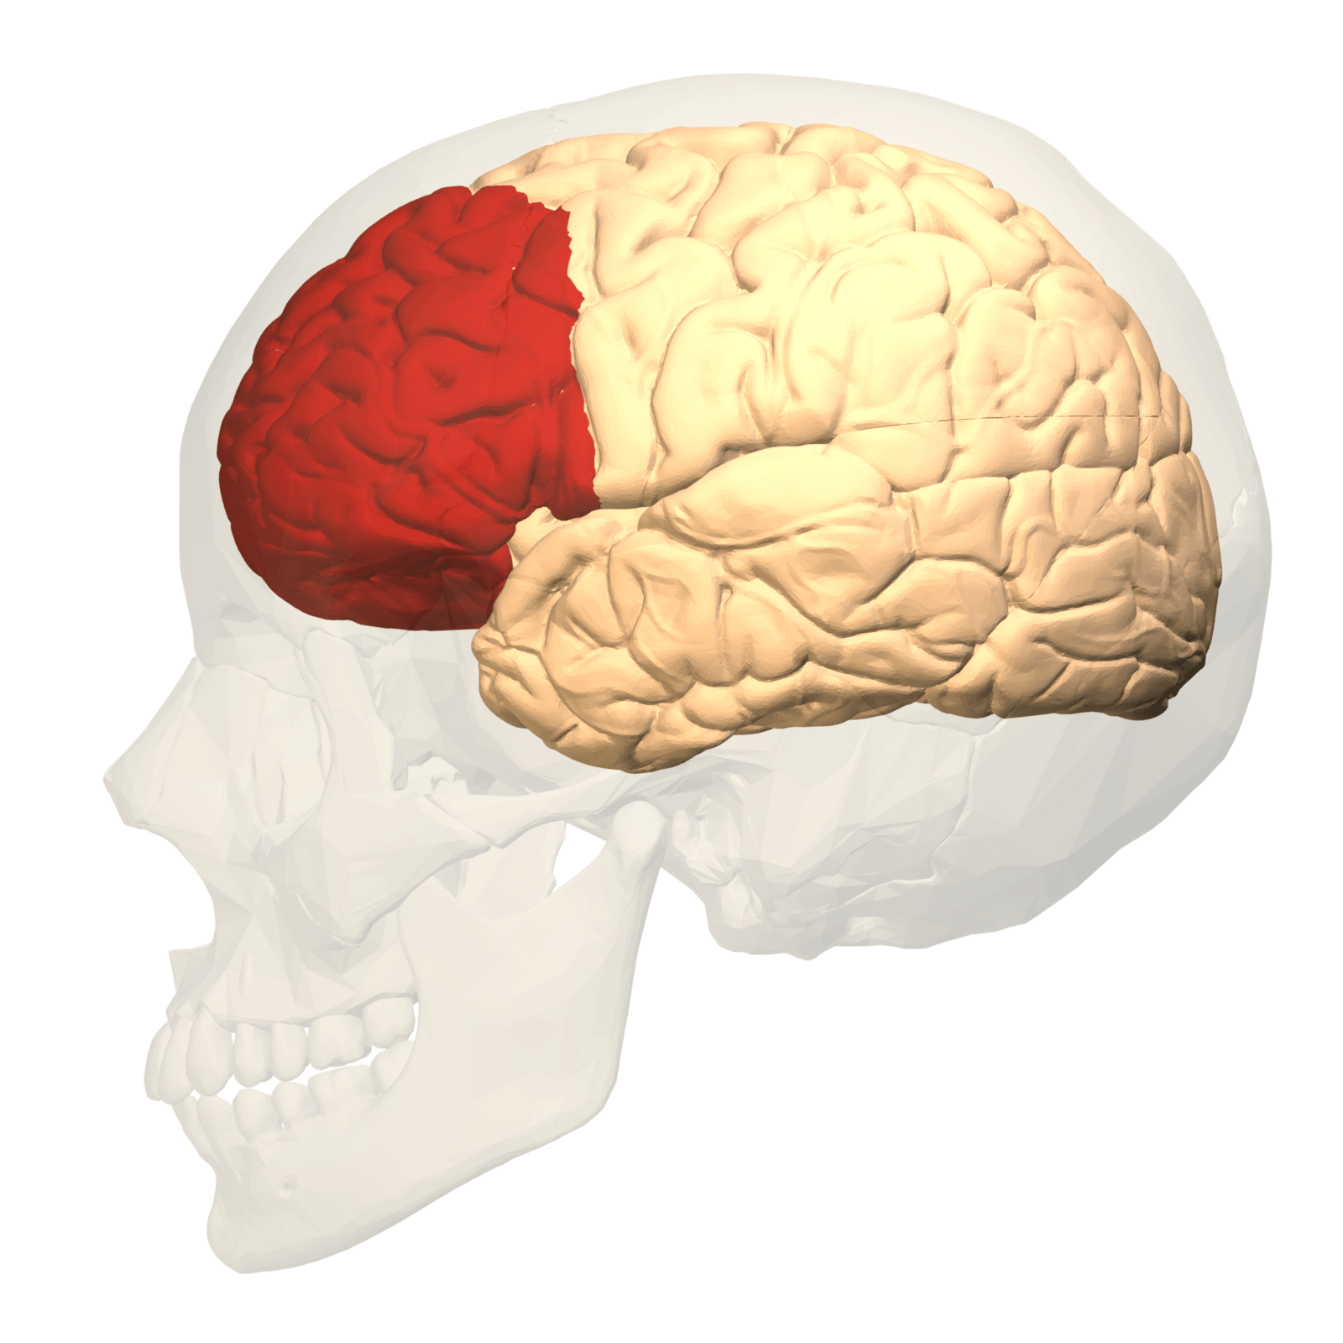
My research program

Slide 4
Functional brain imaging

Slide 5
Functional near infrared spectroscopy (fNIRS)

Slide 6
How did you achieve this skill?
Immersion
Build a team

Slide 7
Were there any barriers to achieving this skill?
Immersion
Resources
  Scrappy and resourceful

Slide 8
What is the utility of this skill in academia?
Interdisciplinary

Slide 9
What is the utility of this skill in industry?

Slide 10
How do you feature this skill on a resume/CV?
1. Buzz words (use with caution)
Cutting-edge technology
Advanced neuroimaging
2. Emphasize how the technology is facilitating interdisciplinary research
3. Emphasize the diversity of skills you’re offering trainees

Slide 11
Questions?
Barbara Fenesi, Ph.D.
Assistant Professor, Faculty of Education
Brain Mind Institute
WEBB Lab - webbresearch.ca
bfenesi@uwo.ca

